Slide 1

Team Name : OG404
Team Leader Name : Jeejo Joy
Problem Statement: Market conditions change fast. Sellers get data, not decisions.

Slide 2

Brief about the Idea: Sellers Are Flying Blind
Indian sellers competing against hundreds of sellers on Amazon, Flipkart, and Meesho—but they can't see what's happening in the market.
The result?
Prices set by guesswork, not data
Stockouts when demand spikes
Overstock when demand drops
Lost sales to better-positioned competitors
It's like playing chess blindfolded while everyone else can see the board.
The Solution: ShelfIQ - Your AI Co-Pilot
Think of ShelfIQ as your always-on market analyst:
🔍 Watches → Tracks competitor prices and market trends continuously 🧠 Thinks → AI predicts demand and calculates optimal prices 💡 Advises → Recommends specific actions: "Adjust your price" or "Restock soon" ⚡ Alerts → Notifies you instantly when competitors move or margins drop
In simple terms: ShelfIQ turns market data into decisions you can act on automatically.

Slide 3
What Makes ShelfIQ Different?
Meet Rajesh
Small seller | Flipkart & Amazon | Home Appliances | Pune
❌ Before ShelfIQ: Constant Fire-Fighting
Morning: Manually checks competitor prices for hours Afternoon: Misses competitor price drop → Loses sales Evening: Guesses inventory for Diwali → Wrong stock Night: Discovers selling at loss
Result: Stressed, reactive, losing money
✅ After ShelfIQ: Proactive & Growing
Morning: AI alert → Applies recommendation instantly Afternoon: Demand spike predicted → Restocks confidently Before Diwali: Accurate forecast → Perfect inventory Continuous: Margins protected automatically
Result: Calm, proactive, profitable

Slide 4
🔍 COLLECT → 🧠 ANALYZE → 💡 RECOMMEND → ⚡ EXECUTE
Conversational Commerce Intelligence
(Not Just Analytics)
Others: Show data → You decide
ShelfIQ: Recommend action → You execute
Most sellers aren't data analysts. They need decisions, not dashboards.
India-First AI Models (Not Just Localization)
Trained on Indian festivals, regional pricing, marketplace behaviors ( "Diwali in 2 weeks. Ethnic wear demand will spike 8x.”)
Action-First Architecture (Not Insight-First)
Every insight = Recommended action + One-click execute
(Traditional: "Your listing has low visibility"
ShelfIQ: "Add these 5 keywords to your title. [Apply Now] Expected: +20% visibility” )

Slide 5
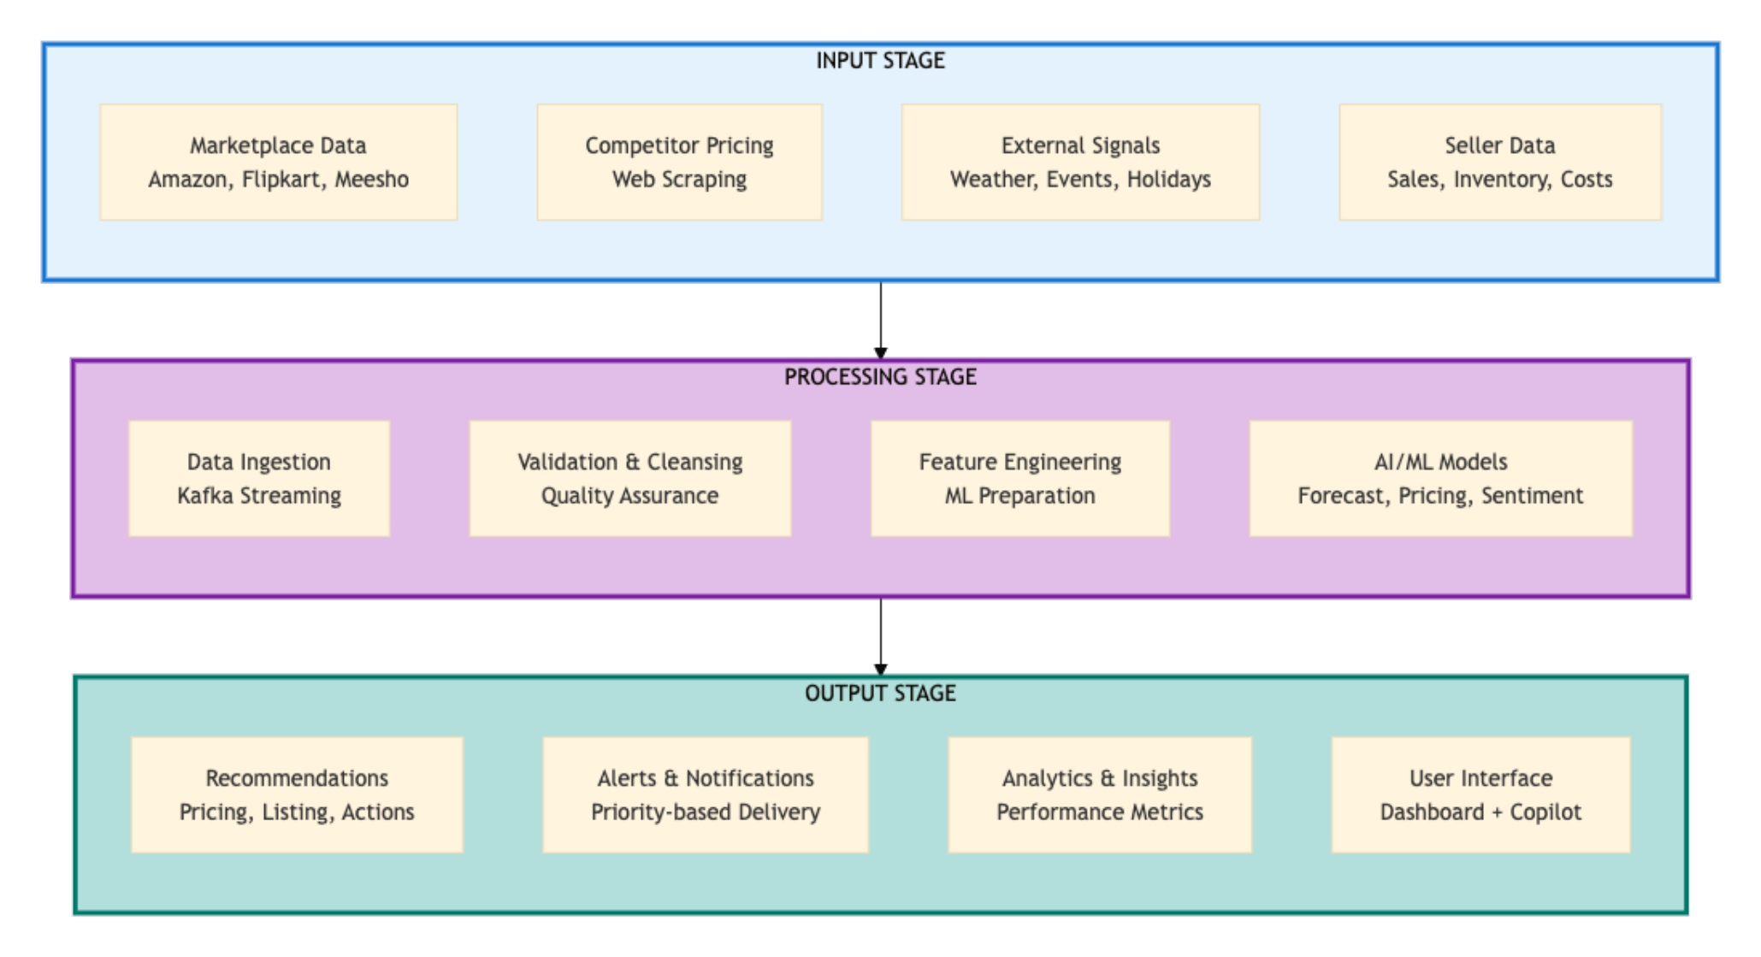
Process flow diagram or Use-case diagram

Slide 6
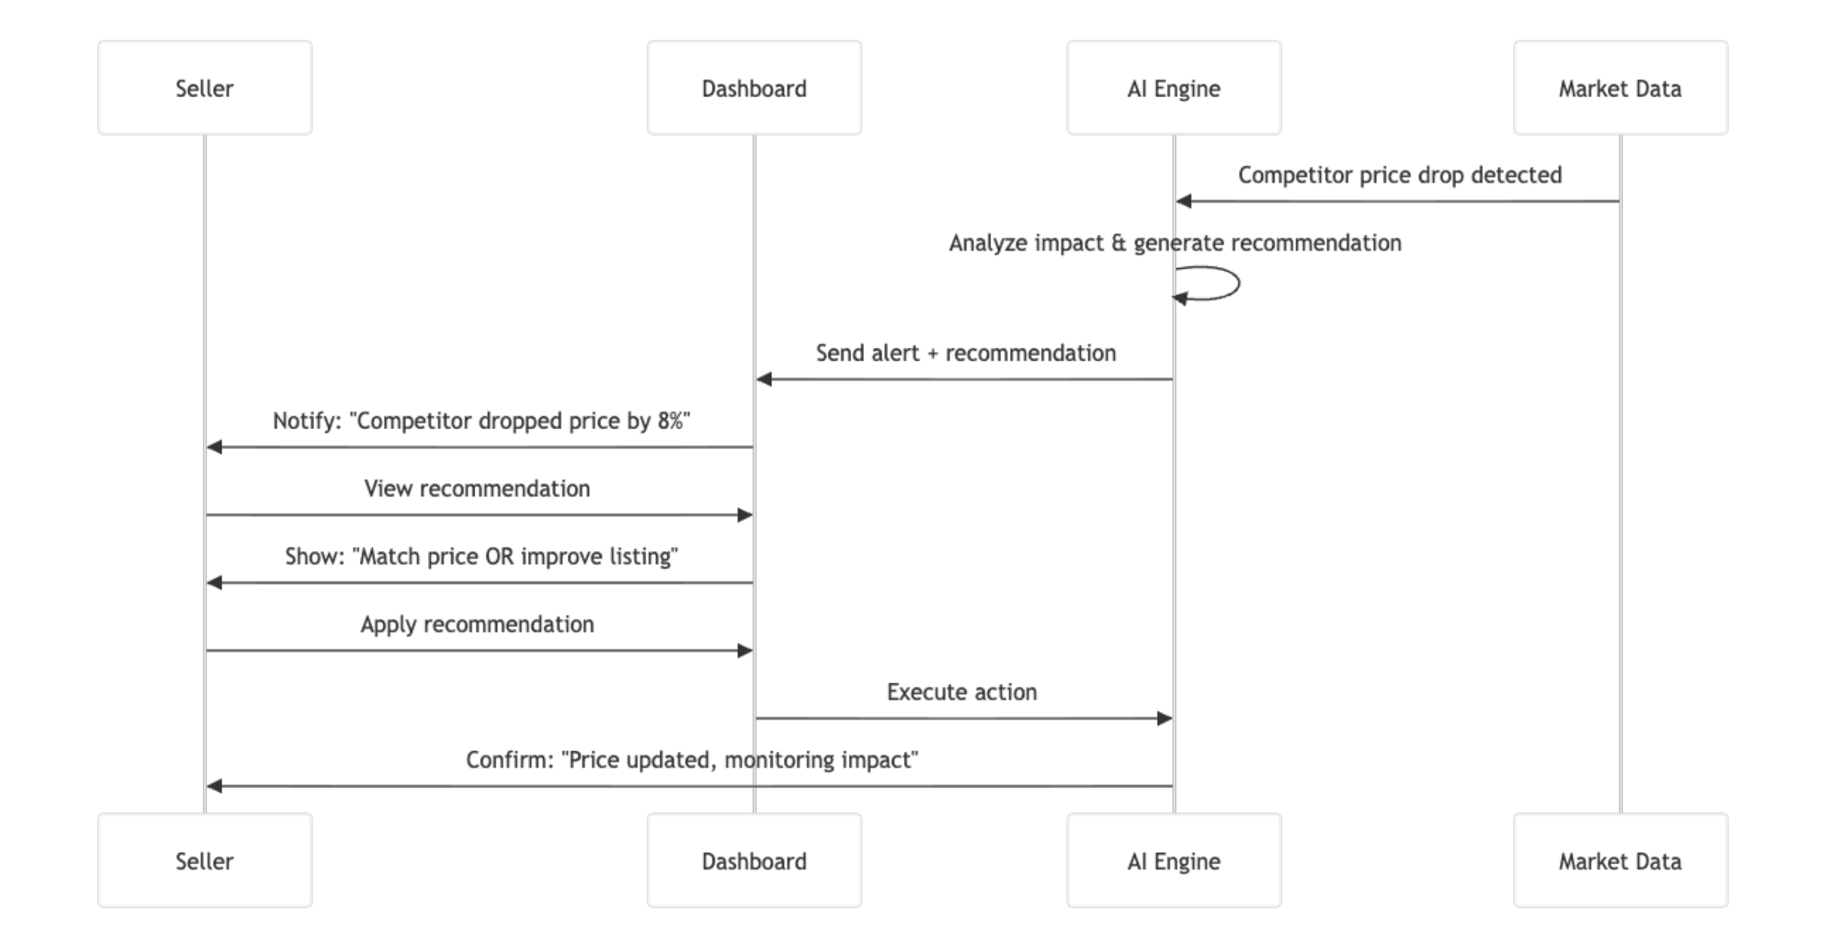
Wireframes/Mock diagrams of the proposed solution (optional)

Slide 7
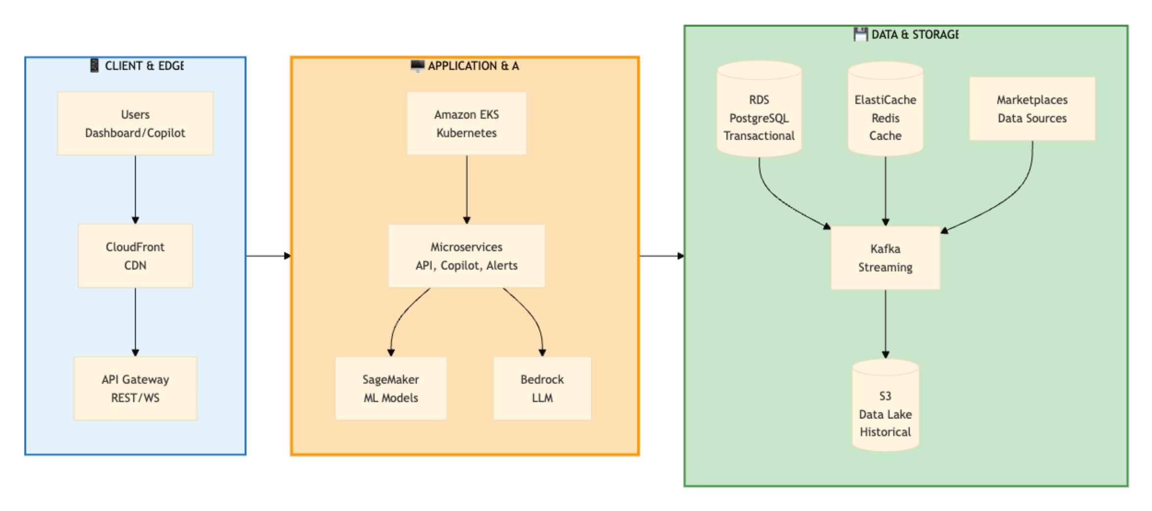
Architecture diagram of the proposed solution:

Slide 8
Technologies to be used in the solution:
Frontend: React 18 + TypeScript | Material-UI | Recharts | Socket.io
Backend: FastAPI (Python) | Node.js | GraphQL (Apollo) | Kong Gateway
AI/ML: • Forecasting: Prophet + LightGBM + LSTM • Pricing: Bayesian Regression + Optimization • NLP: DistilBERT | GPT-4 (Copilot) • Serving: TensorFlow Serving | MLflow
Data: Kafka | Flink | Airflow | Feast (Feature Store) | S3 Data Lake
AWS Services: • Compute: EKS (Kubernetes) • Database: RDS PostgreSQL | ElasticCache Redis • ML: SageMaker | Bedrock • Storage: S3 | Monitoring: CloudWatch
DevOps: Docker | Terraform | GitHub Actions | ArgoCD | Prometheus

Slide 9
Estimated implementation cost (optional):

Slide 10
AWS Services Used
Amazon SageMaker for ML training and deployment
Amazon Bedrock for conversational AI copilot
Amazon EKS for container orchestration
Amazon RDS and ElasticCache for data storage
Amazon S3 and AWS Glue for data lake and ETL
Amazon CloudWatch and AWS X-Ray for monitoring and observability
Bharat-Specific Features
Multi-language support including Hindi, Tamil, Telugu, Bengali, and Marathi
Festival demand intelligence for events like Diwali, Holi, and Eid
Support for Indian marketplaces such as Flipkart, Meesho, and Amazon India
Designed for Tier 2 and Tier 3 sellers with low-bandwidth optimized UI
GST-aware pricing and compliance support
Social Impact
Empowering MSMEs to make better pricing and inventory decisions
Improving revenue stability for small sellers
Supporting growth of new e-commerce entrepreneurs
Innovation
Conversational AI copilot built specifically for Indian e-commerce sellers

Slide 11


